Slide 1

: AIGC Powered Multimedia
Interactive Entertainment Platform for ACG Fans

Slide 2
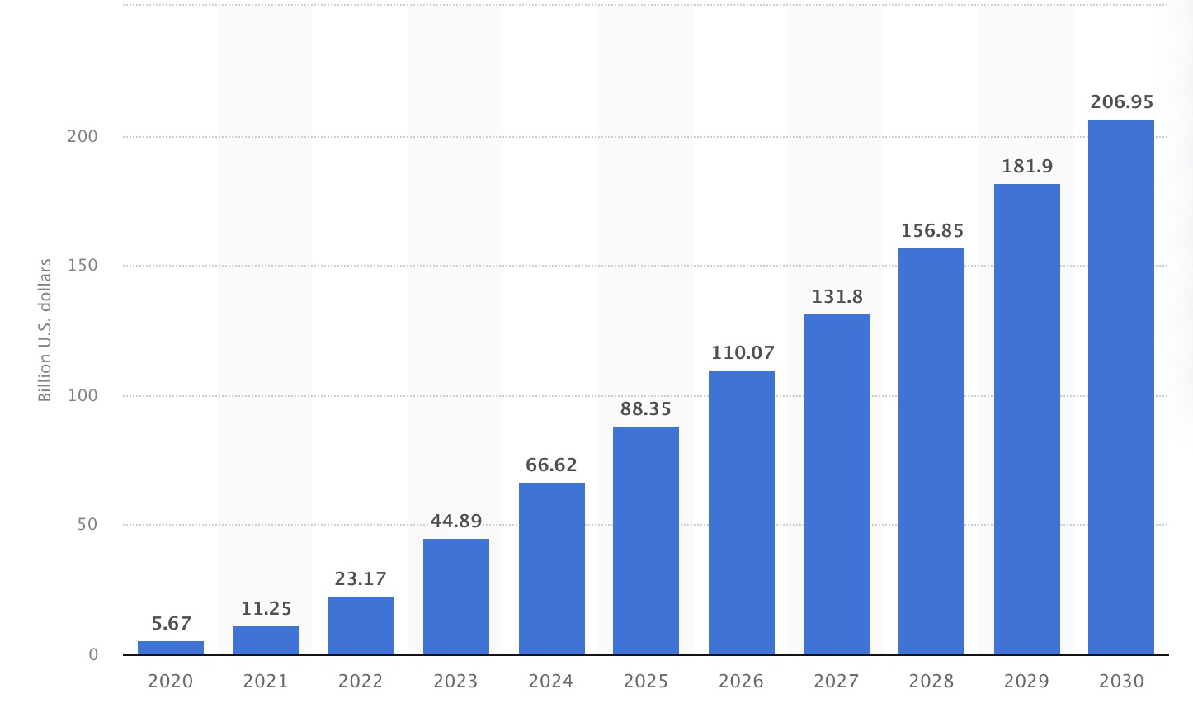
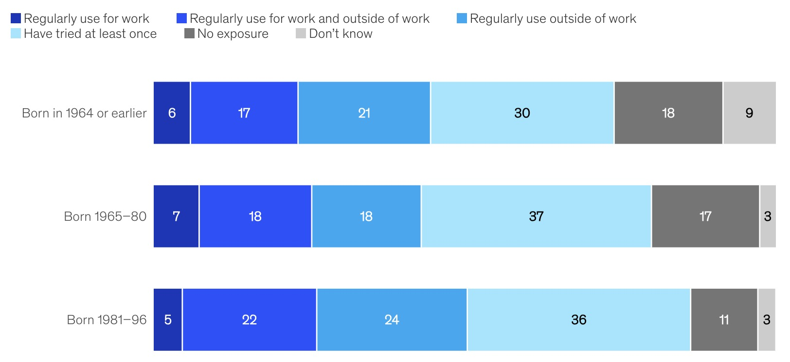
Generative AI is Reforming Human Society
Generative AI has achieved remarkable advancement over the past few years.
It is capable of generating texts, images, videos and audios with prompts from human.
Relevant applications are boosting productivity and creating values across various sectors.
The market size is estimated to grow from $45B in 2023 to $207B by 2030.
Estimated market size of generative AI 2020-2030, source: statista
Exposure to generative AI by different age, source: McKinsey & Company

Slide 3












Current Situation for Generative AI Markets
The costs of developing of generative AI models are extremely high.
The majority of market shares are occupied by leading companies especially OpenAI.
It is difficult for new comers to catch up with the established players.
Most of the generative AI giants focus on Large Language Model (LLM) based services.
Multimedia interactive experience with visible and hearable results are desired.
Opportunities remain for segment markets, unique technologies and good business models.

Slide 4










Market Opportunities Match Our Advantages
Traditional digital human:
High cost to train individual models
Large Language Model:
Only text, but multimedia feedback wanted
Digital celebrities / real person:
Potential privacy / identity risks
Market Oppotunities
Our Advantages
low latency
~50ms
We provide multimedia immersive experience. By combining LLM, TTS and Image2Video technologies, we can generate talking head videos with given reference audio and image at low latency.
With all members being ACG fans, we have better sense of ACG related products and closer access to IP rights, with connections in animation industry.

Slide 5
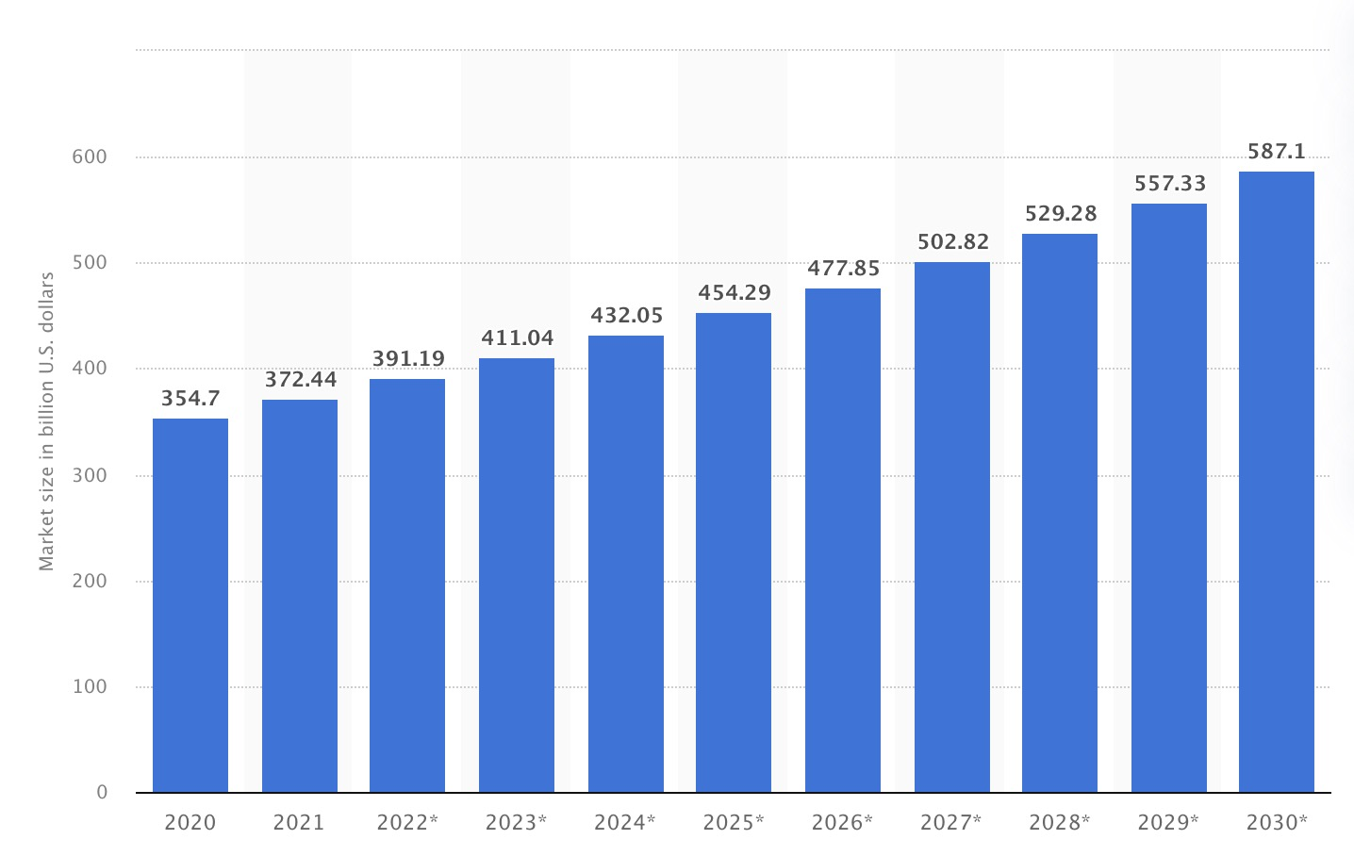
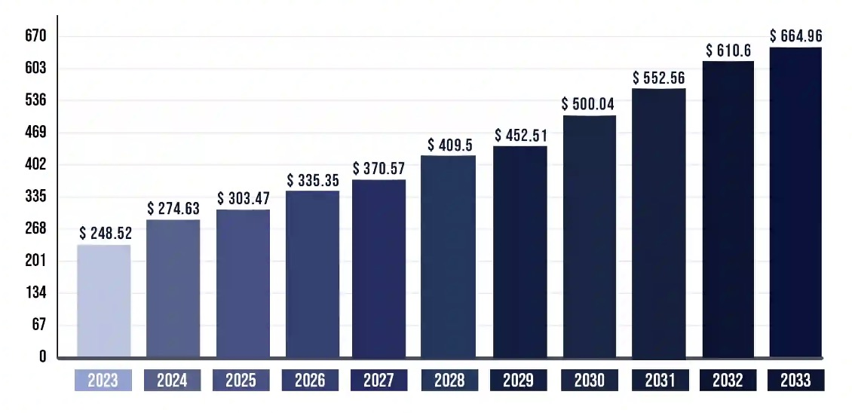



Market Opportunities for ACG Fans
The market size and potention for ACG (animation, comics and game) are huge.
Users not satisfies with current contents sometimes, creation of derivatives is thriving.
Interactive experiences are in high demand, current vtubers have human involved.
AI powered products already in the market, but focus on single functionality.
Great potential for AI powered interactive multimedia services supporting UGC.
Estimated Animation market size 2020-2030, source: statista
Estimated video games market size 2023-2033, source: precedenceresearch

Slide 6



Our Products
Multimedia interactive experiences driven by generative AI for ACG Fans.
Users can customize ACG characters with unique personalities, appearances and voices.
We show two demos generated by Zero-shot algorithms with a single forward pass and no training is needed:
Ayanami Rei, Prompt: Shinji is frustrated with his dad, could you encourage him?
Sohryu Asuka Langley, Prompt: I know you also have an affection on Shinji, why not tell him frankly?
Ref voice of Ayanami：
Ref voice of Asuka：

Slide 7




Our Products
AI backend
Digital character
Text prompt
Reference image
Reference voice
Result video
User inputs
System output
Users

Slide 8
Technology Architecture
Frontend
Backend
Reference voices
Zero-shot
Text-to-Speech
Website
GeneratedTexts
Voice Prompts
Speech
Recognition
users
Android
Application
Generated
Voices
Texts Prompts
Large Language Model
Text2Image
generation
IOS
Application
Reference images
Zero-shot
Talking-head
AR/VR
Devices
Generated
Videos

Slide 9




Our Superiorities Over Competitors
Provides LLM based chatbot / AI companionship services with texts and voices as feedback. They can not generate visible results such as videos, nor could the voices be customized.
Is an AI video generator to create talking head videos of digital human. It is time consuming, and only generate videos but can not interact with users.
Are developer platforms to store and share code / ML model weights. They only allows the sharing of files but can not host executable programs
Compared to Character.AI and Candy.AI, we provide multimedia experiences with videos and allow users to customized appearance and voices; Compared to HeyGen, we are fast and have LLM backend for digital characters to provide interactive experiences; Compared to HuggingFace and GitHub, creators can host and share digital characters on our platform for other users to experience.

Slide 10


Business Model: Entertainment Service Provider
We provide multimedia interactive entertainment services of ACG characters for individual users. Revenues are generated from membership subscription or charging by the amount of usage.
✗
✓
Suppose you are a fan of Attack on Titan and not happy with the ending. You can write your own plots with given prompts, Allen and Mikasa will tell you their stories with their own voices and lively facial expressions.
Suppose you want a virtual friend, you can customize the person with your preferred looks, voices and personalities by providing reference images, audios and backstories of the person.

Slide 11

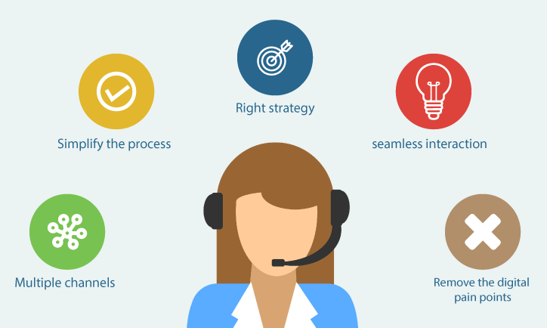


Business Model: Digital Human Solution Provider
We provide digital human services that could be customized by specific needs from users. Revenues are generated from membership subscription or charging by the amount of usage.
Small business owners can host digital human for unmanned customer services with customized appearance，voices and domain knowledge through our platform.
Independent game producers can seamlessly integrate our customizd digital human service into their workflow to develop visual novels and adventure games (AVG).

Slide 12
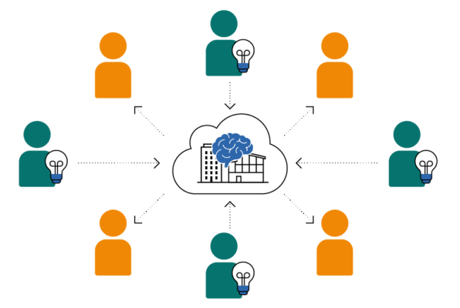
Business Model: UGC Sharing Platform
We build a platform for users to share their customized digital characters. Users can sell or rent their generated contents in our platform and we make revenues by charging the transections.
Content creators can publish their generated digital human or videos/audios/images for free or with certain prices on the platform. Content consumers can also find their favorite contents from the sharing platform. Github is the place to share codes, Hugging Face is the place to share ML model weights, and we are building the platform to share digital human.

Slide 13



Core Members
XIE MENG (谢 萌), Partner
B.Eng & M.Eng, USTC
CEO, Shenzhen Jichen Tech Co.Ltd
Director of R&D, Unity Drive
DJI RoboMaster, Top8 team leader
WANG XINRUI (王 欣睿), CEO
M.Sc & Ph.D candidate, Matsuo Lab, UTokyo
B.Eng, Mechanical Enigneering, USTC
Japan Computer Vision, senior ML engineer
Tencent WXGroup, ML engineer
ByteDance AI Lab, ML engineer
Multiple papers accepted by CVPR & ICML
3 Chinese & international patents issued
ZHANG XIN (张 鑫), Advisor
M.Sc & Ph.D, Matsuo Lab, UTokyo
CEO, AI Mage Inc
Collaboration with anime studios
Granted by MITOU Project of Japanese government
Accepted by 1st Round, UTokyo IPC
Former PRO Shogi player

Slide 14
Our Goals
Build the World Largest Interactive Entertainment and UGC sharing Platform for ACG Fans
We also have an estimated roadmap for the following 2 years：
Raise seed round of $1M;
Build a team of 3~5;
Finish ML functions integration;
Basic functions online;
50k seed users;
Estimated value $7M
Raise round A of $2M;
Expand team to 8~10;
Android & IOS APP online;
Digital human solution ready;
100K DAU and 500K MAU;
Estimated value $25M
Raise round B of $5M;
Expand team to 20~30;
Start membership subscription;
UGC sharing platform online;
300K DAU and 1M MAU;
Estimated value $70M
1st -6th Month
7th -12th Month
13th -24th Month

Slide 15
Our Schedules for the First 6 Months
1st Month
2nd Month
3rd Month
4th Month
5th Month
6th Month
Raise seed round of $1M
$30K for business trip
Build a team of 3-5 fulltime employees
$250K for office rent, equipments, salariy, employee benefits and daily operation
Integrate ML modules into cloud backend
$100K for GPU server rent
Joint debuging and optimize ML fuctions
$70K for LLM API cost
Develop web frontend and cloud backend
$100K for cloud server rent and daily operation cost
Joint debugging of frondend & backend
$50K for out-source developments and realated resources
Publicize our product in ACG communities
$100K for PR and advertisement
Search for potential clients & collaborators
$50K for business trip and recption fees

